Slide 1


GOOGLE PLAYSTORE DATA ANALYSIS AND RATING PREDICTION
Institute of Advanced Computing and Software Development, Pune
Post Graduation Diploma in Big Data Analytics
Feb-2020
By :
Mayuri Shivshette. -1327
Vaibhavi Naphade –1349
Project Guide :
Mr. Akshay Tilekar.

Slide 2
Contents
Project Abstraction
Goals and Objectives
Project Requirements
Dataset Description
Data Pre-Processing
EDA
Data Visualization(DashBoard)
Model and Algorithms
Future Scope
Conclusion

Slide 3
Abstraction
This project aims to achieve, fairly accurate rating prediction for different apps by using machine learning algorithms and by visualizing different analytics concept using Seaborn libraries and Tableau. Used dataset has 13 diff features that can be used for predicting whether an app will be successful or not by applying various ML algorithms, like Logistic Regression, Decision tree, etc and by comparing all models ,we have selected optimal performing model to predict ratings of apps.

Slide 4
Goals and Objective
To Visualize the data set and Analyze the each categories, Installs and other features
To Predict the Rating for Application to decide the application will be success or not considering other features from the application

Slide 5
Project Requirement
Dataset:-Google Play Store Data Analysis and Rating Prediction
Software Requirements:- Jupyter Notebook
Programming Languages:-Python, Machine Learning Algorithm
Libraries:-
Data Visualization:-Seaborn ,Matplotlib
Machine Learning Models:-Sklearn,Pandas,Numpy

Slide 6
Dataset Description
Dataset Consist of Total 23 Column and 1118136 Rows:
App Name ,App Id, Category
Rating, Rating Count, Installs,
Minimum Installs, Maximum Installs, Type,
Price, Currency, Size, Minimum Android,
Developer Id, Developer Website, Developer Email,
Released, Last Updated, Content Rating,
Privacy Policy, Ad Supported, In App Purchases, Editors Choice

Slide 7
Data Pre-Processing
Identified Counts of each Categories
Identified Unique values of each Categories
Identified Null values
Checked Duplicate values
Replaced Null values checking Data Stability
Dropped Few columns , etc

Slide 8
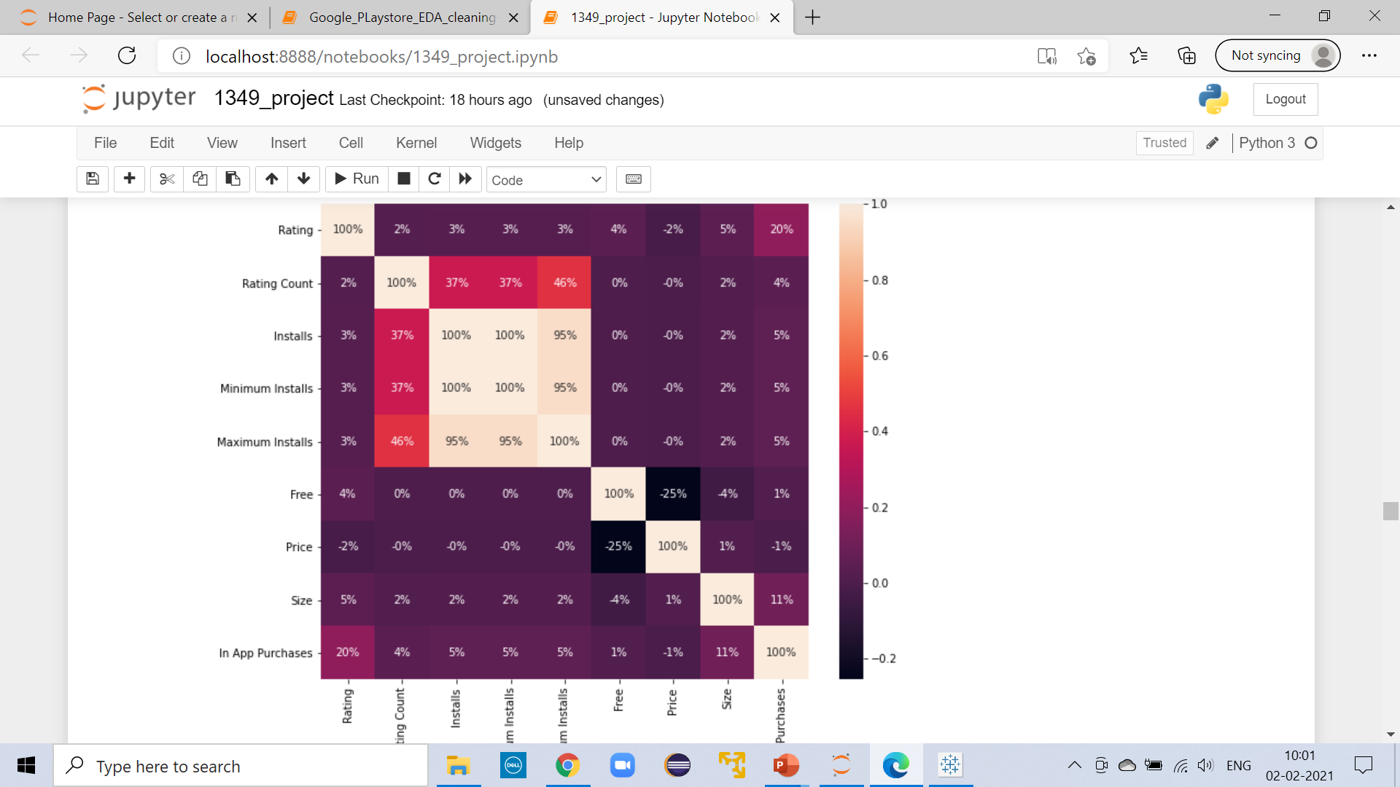
Correlation plot:-Below graph shows the correlation of each features

Slide 9
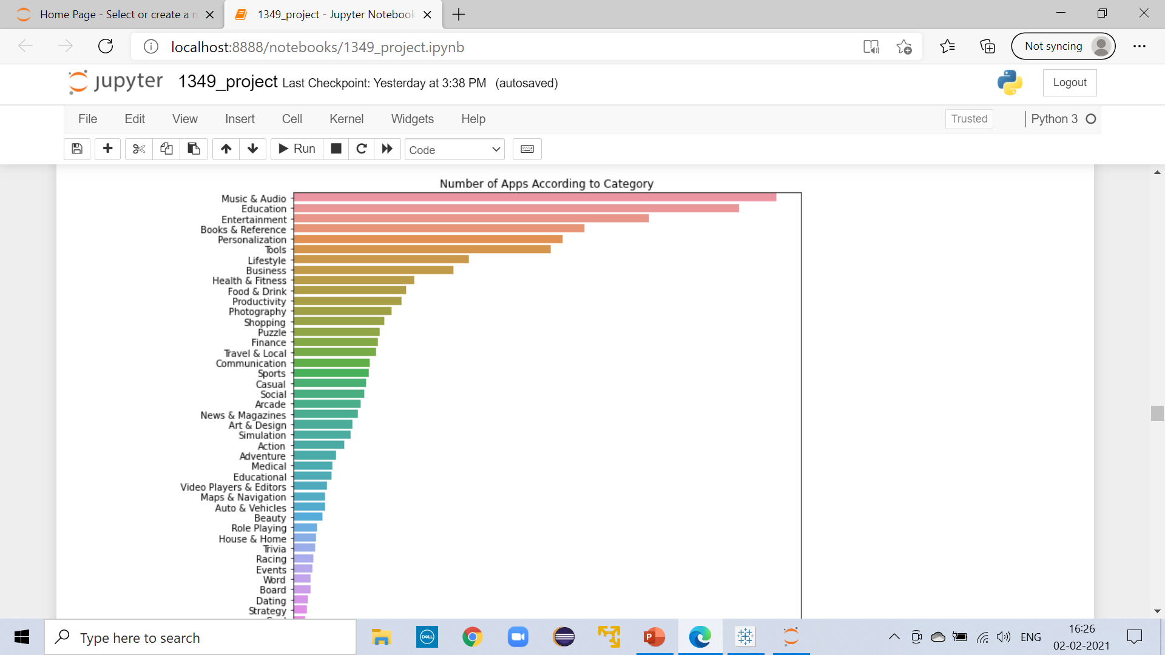
Number Of Apps According to Category: As Shown in fig Music & Audio, Education and Entertainment categories has highest no. Of application.

Slide 10
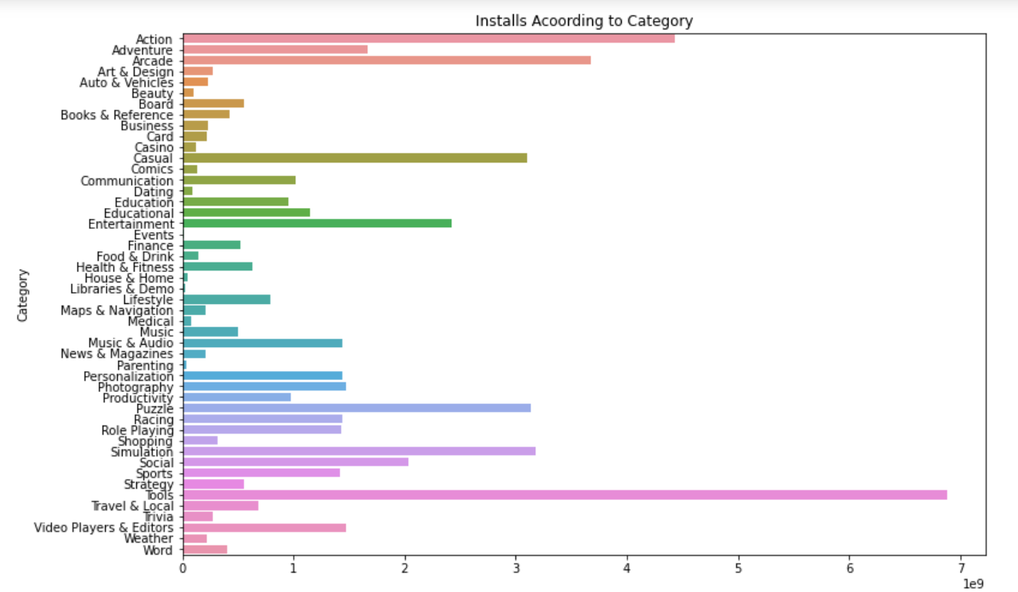
Most Installed Category:- As Shown in fig Tools is the most installed category.

Slide 11
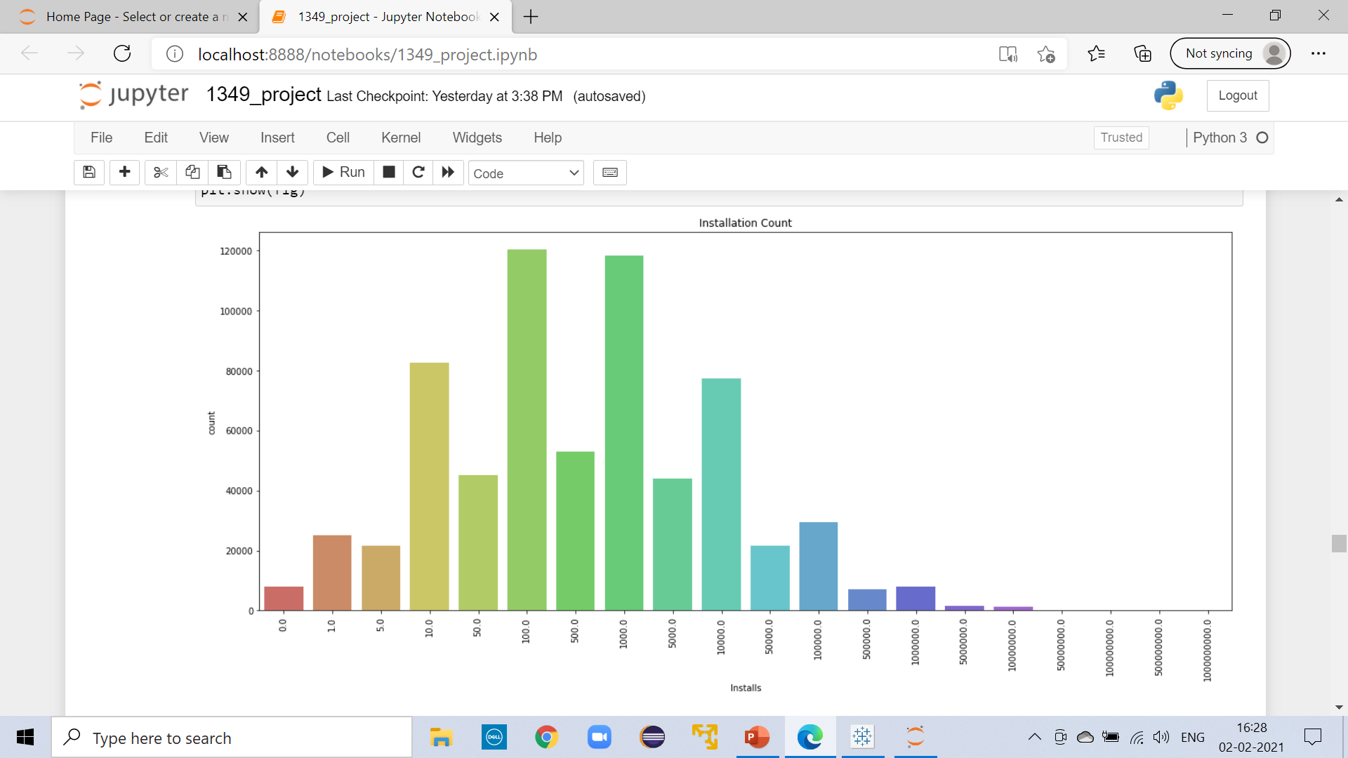
Installation Count:-Below Graph shows the count for Installation number.

Slide 12
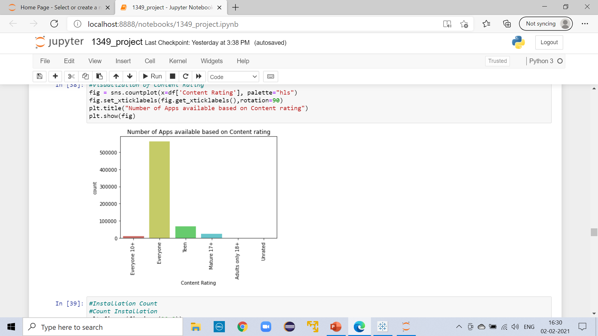
Content Rating :-Below Graph shows the number of Apps available based on Content Rating.

Slide 13
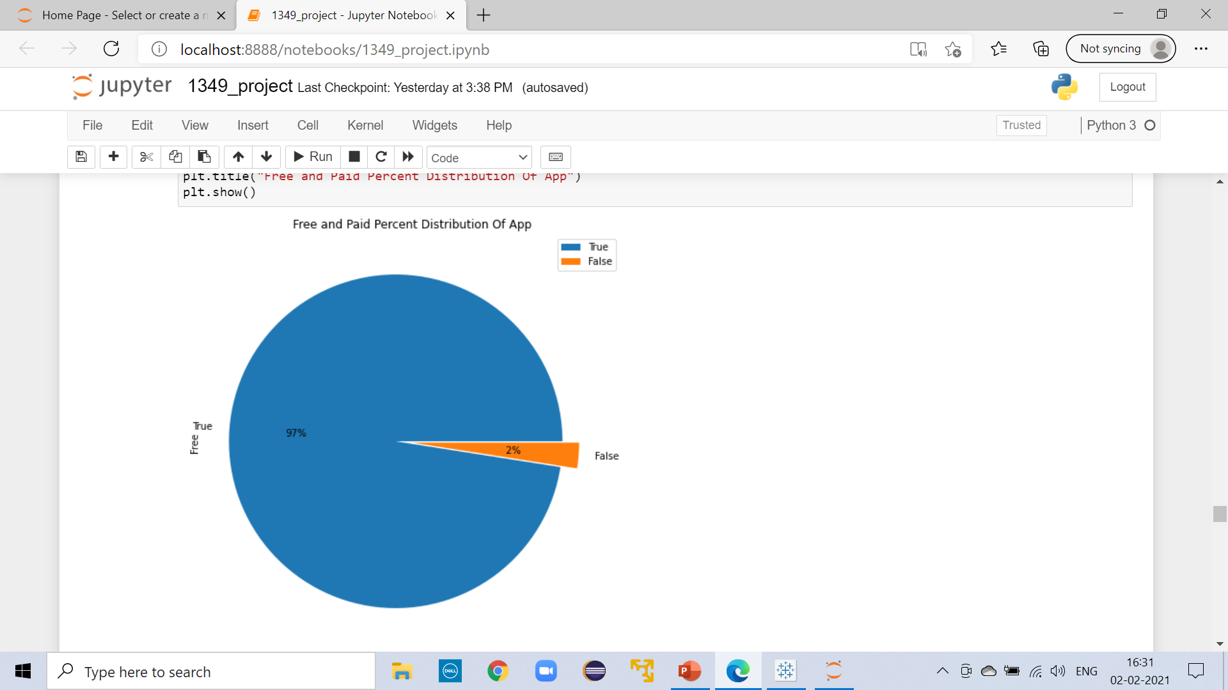
Type of Applications(Free or Paid):-Below Fig shows the distribution percentage of free and paid app available on google play store.

Slide 14
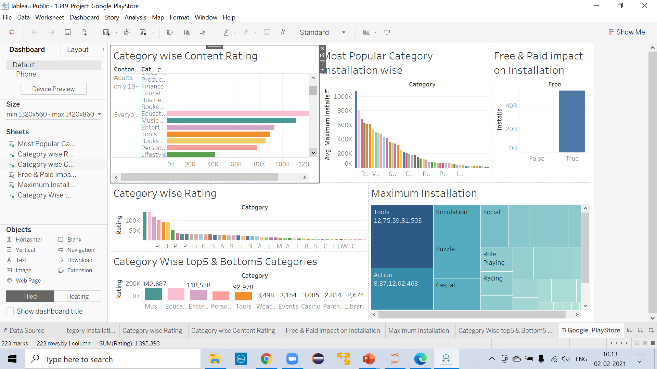
DashBoard

Slide 15
Model and Algorithms
pre_sample_dum
Algorithms :
Logistic Regression_accuracy: 50%
Bernoulli Naive Bayes_Accuracy: 79.40%
DecisionTree Classifier_Accuracy: 74.88%
RandomForest_Accuracy: 79%
CatBoost_Accuracy: 81%

Slide 16
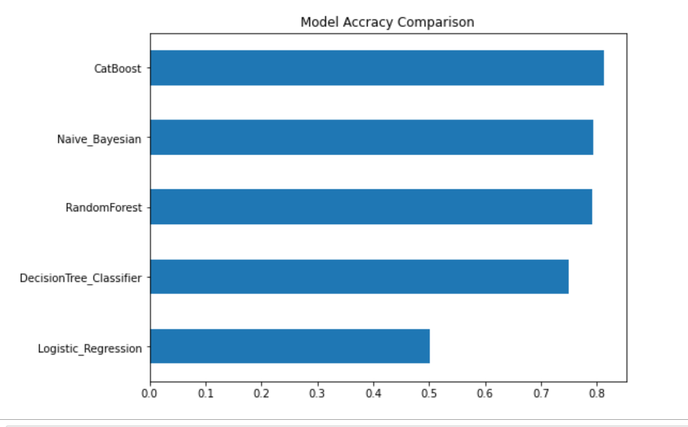
Model Accuracy Comparison:- As below graph shows CatBoost Algorithm as given Highest accuracy of 81%.

Slide 17
Future Scope:
UI Design for Recommendation of Apps for different categories according to rating which is given by customers who have installed it already.
Predication of Installation of Application

Slide 18
Conclusion
The Play Store apps data has enormous potential to drive app-making businesses to success. Actionable insights can be drawn for developers to work on and capture the Android market!
This shows that given the Size, Type, Price, Content Rating, and Genre of an app, we can predict about 81% accuracy if an app will hit on the Google Play Store.

Slide 19

Thank You

